Slide 1
8259 (PIC)
Programmable Interrupt Controller (PIC)

Slide 2
8259
8259 is Programmable Interrupt Controller (PIC)
It is a tool for managing the interrupt requests.
8259 is a very flexible peripheral controller chip:
PIC can deal with up to 64 interrupt inputs
interrupts can be masked
various priority schemes can also programmed.
originally (in PC XT) it is available as a separate IC
Later the functionality of (two PICs) is in the motherboards chipset.
In some of the modern processors, the functionality of the PIC is built in.

Slide 3
Pin description
8-bit bi-directional data bus, one address line is needed,
PIC has two control registers to be programmed, you can think of them as two output ports or two memory location.
The direction of data flow is controlled by RD and WR.
CS is as usual connected to the output of the address decoder.
Interrupt requests are output on INT which is connected to the INTR of the processor. Int. acknowledgment is received by INTA.
IR0-IR7 allow 8 separate interrupt requests to be inputted to the PIC.
sp/en=1 for master , sp/en=0 for slave.
CAS0-3 inputs/outputs are used when more than one PIC to cascaded.

Slide 4
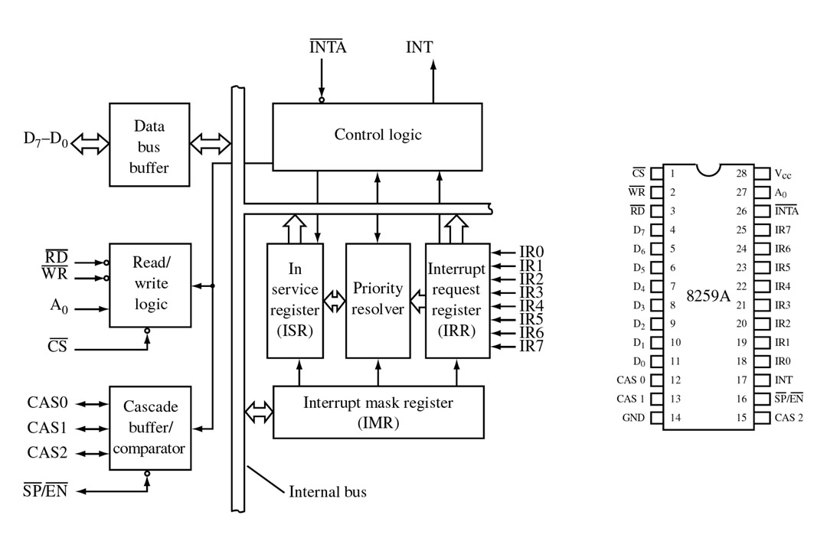
FIGURE 9-4 Block diagram and pin definitions for the 8259A Programmable Interrupt Controller (PIC). (Courtesy of Intel Corporation.)
John Uffenbeck The 80x86 Family: Design, Programming, and Interfacing, 3e
Copyright ©2002 by Pearson Education, Inc. Upper Saddle River, New Jersey 07458 All rights reserved.

Slide 5
OPERATION
PIC is to be initialized and programmed to control its operation.
The operation in simple words:
when an interrupt occurs , the PIC determines the highest priority, activates the processor via its INTR input, and sends the type number onto the data bus when the processor acknowledges the interrupt.
Priority:
What is used in PC is fully nested mode. That is the lowest numbered IRQ input has highest priority. Lower priority interrupts will not be forwarded to the processor until the higher priority interrupts have been serviced.

Slide 6
Modes
Fully Nested mode
Special Fully Nested mode
Nonspecific Rotating
Specific Rotating
Special Mask
Polling

